Slide 1
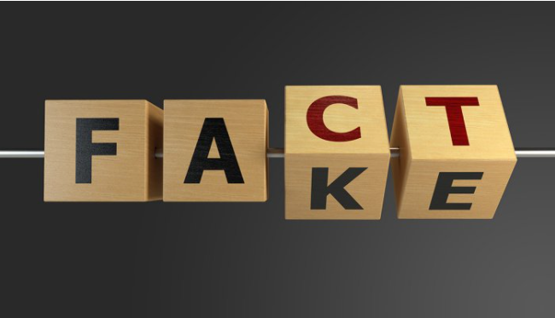
Fake News
Notes:
We have high emotions regarding different products, brands or services. My anger towards Apple company does not benefit me but it can benefit the Apple company, They can use my experience to improve their customer services.

Slide 2
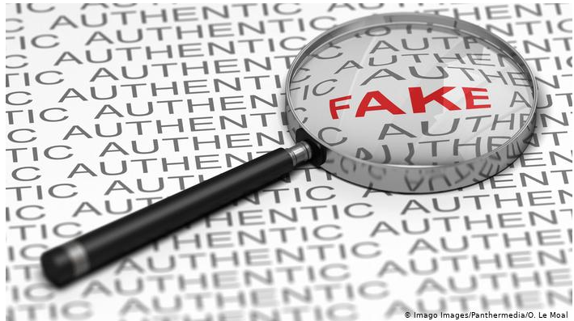
1. Build a model that will predict if a newspaper article is fake or truthful. 2. Find the best predicting model on the Univesity of Victoria dataset. 3. Test the best performing model on the dataset scrapped from The Guardian website.
Goals

Slide 3
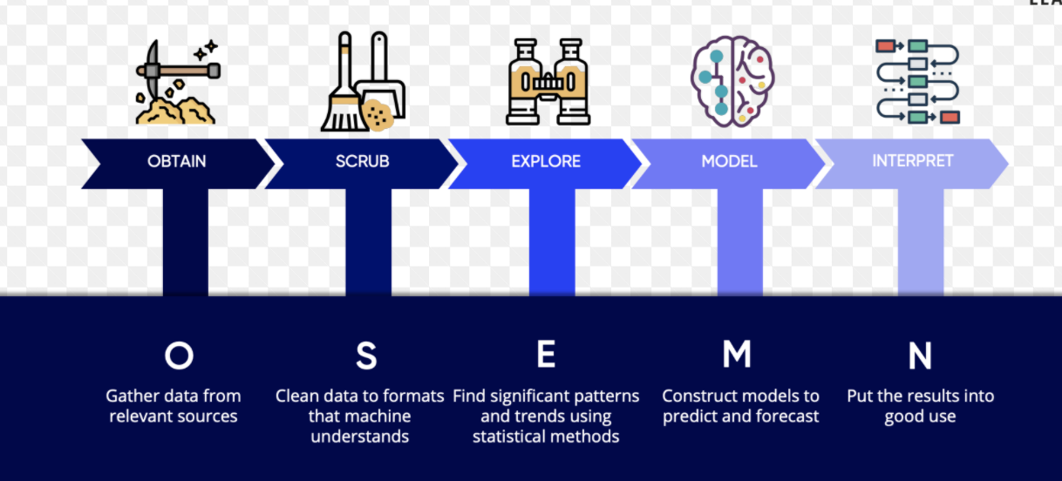
Methodology used

Slide 4

1. Scrape ‘The Guardian’ newspaper website for articles on World News and Politics. 2. Download two datasets from University of Victoria and create a database containing 44898 articles: * 21417 real news articles, * 23481 fake articles. 3. Train and test models on the UV dataset. 4. Test models again on the scrapped data from ‘The Guardian’ website.
Methodology

Slide 5
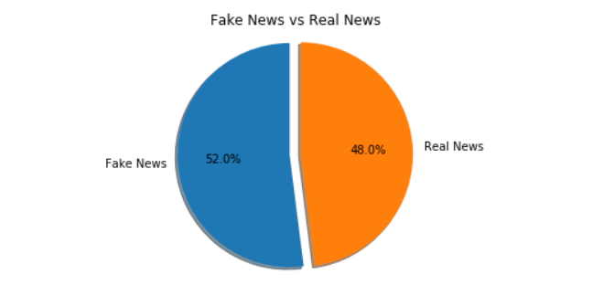
Fake News vs. Real News in UV DAtaset
52% Fake News
48% Real News
Notes:
The dataset is balanced. No need to resample the dataset.

Slide 6
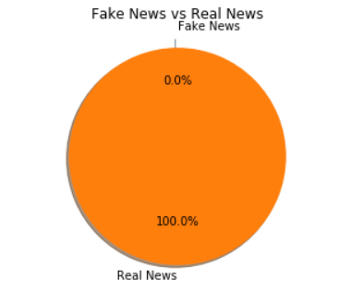
Fake News vs. Real News in The guardian data set
100% REal News.
0% Fake News
Notes:
This works for Classifiers like Naïve Bayes but it doesn’t work for Keras Models. To test the Keras model we will need to add fake news articles.

Slide 7
Accuracy Metrics
Recall
Recall=TP/(TP+FN)
TP is true positives (in this case they are real articles identified as real)
FN is false negatives (in this case they are fake news articles identified as real.
For higher the FN we will have a lower recall.

Slide 8
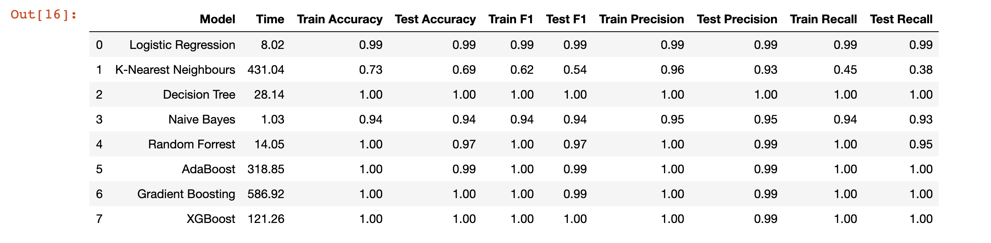
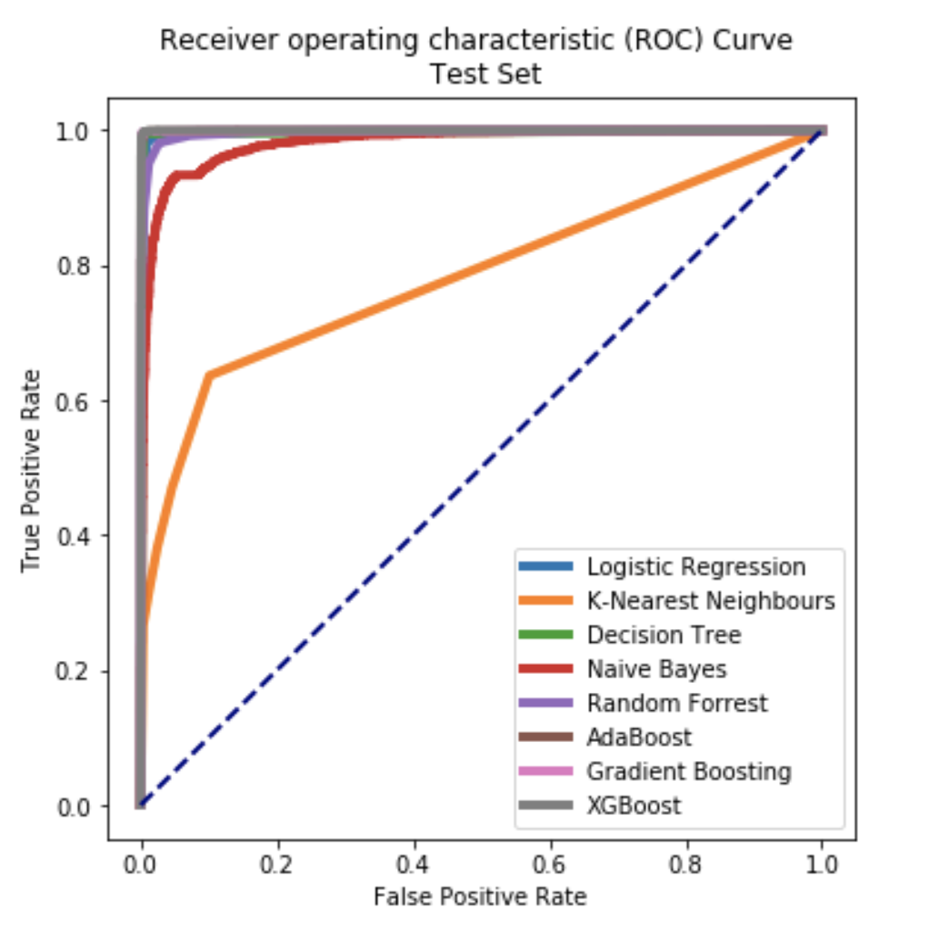
Models
Notes:
Decision Tree, Logistic Regression, AdaBoost, GradientBoosting and XGBoost models test recall is 1. You would think that its perfect, 100% of the time the model identyfies correctly a fake news article. This is why I love statistics because in statistics 100% it too good to be true. There is no perfection, no black and white. There are shades of gray.
An ROC curve (receiver operating characteristic curve) is a graph showing the performance of a classification model at all classification thresholds. This curve plots two parameters:
True Positive Rate
False Positive Rate
True Positive Rate (TPR) is a synonym for recall and is therefore defined as follows:
TPR=TP/(TP+FN)
It measures the real news articles identified as real news out of all real news articles.
False Positive Rate (FPR) is defined as follows:
FPR=FP/(FP+TN)
It measures articles identified as fake news but in reality they are truthful news over all fake news.
AUC stands for "Area under the ROC Curve." That is, AUC measures the entire two-dimensional area underneath the entire ROC curve (think integral calculus) from (0,0) to (1,1).
AUC provides an aggregate measure of performance across all possible classification thresholds. One way of interpreting AUC is as the probability that the model ranks a random positive example more highly than a random negative example.

Slide 9
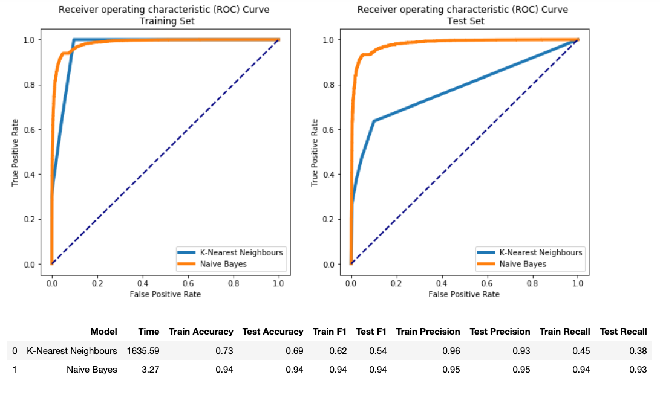
Narrowed list of Models
Notes:
I ended up chosing NaïveBayes and KNNeighbors models to tune because their scores were closer to reality.
K-Nearest Neighbors (KNN) is one of the simplest algorithms used in Machine Learning for regression and classification problem. KNN algorithms use data and classify new data points based on similarity measures (e.g. distance function).
The multinomial Naive Bayes classifier is suitable for classification with discrete features (e.g., word counts for text classification). a Naive Bayes classifier assumes that the presence of a particular feature in a class is unrelated to the presence of any other feature. Bayes classifier performs better than other models with less training data if the assumption of independence of features holds. Naive bayes classifier calculates the probability of a class given a set of feature values (i.e. p(yi | x1, x2 , … , xn)).

Slide 10
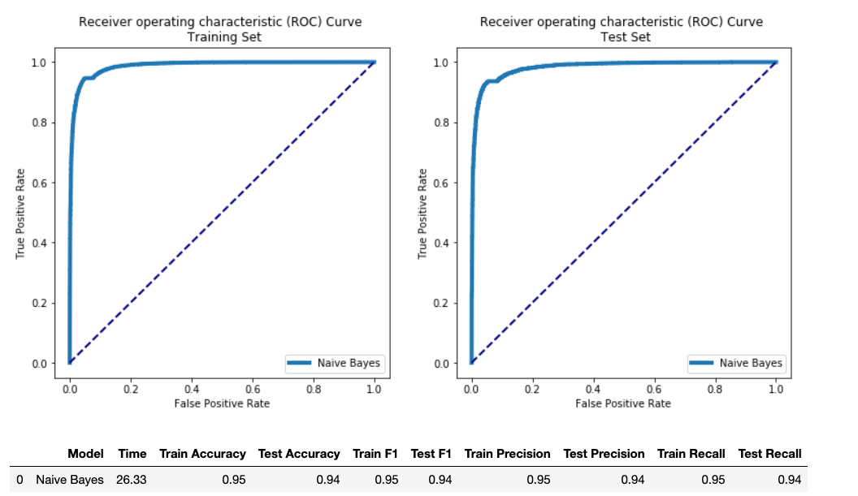
Tuned Naive Bayes model
Notes:
Since the KNNeighbors took more than to days to tune I chose the Multinomial Naïve Bayes model to tune.

Slide 11
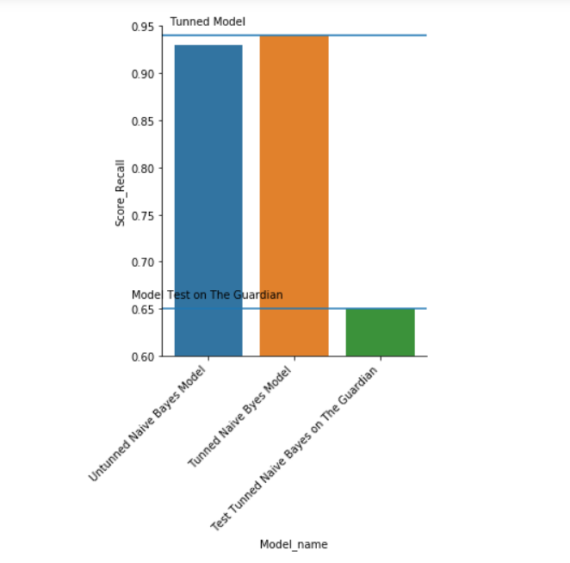
Models Comparison
Notes:
I tested the tuned model on the scrapped data and the recall score was 0.65. Not the best result maybe because the news were focused on UK articles and the modeling was on US news.

Slide 12
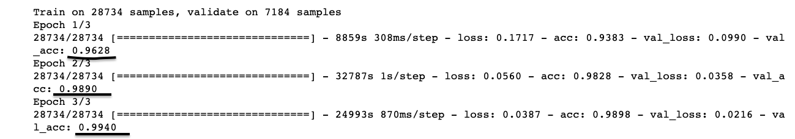
keras Model
Notes:
The Keras model had an accuracy of 0.99 which is again too good to be true. Accuracy is lower when you have wrongly falsely identified news. In our case recall is more precise since we don’t really care about fake news that are identified as real.

Slide 13
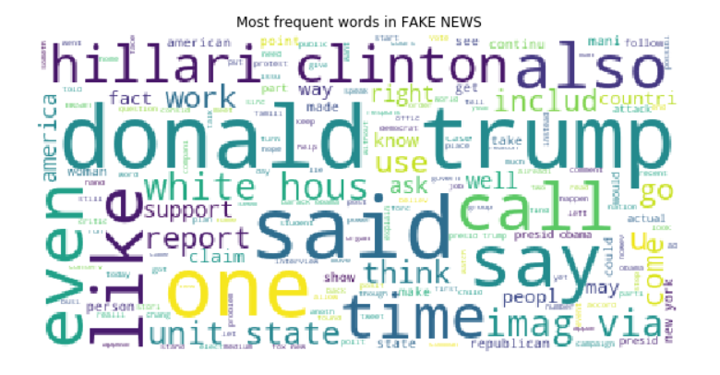
Findings
Most common words in fake news articles:
Notes:
It’s funny, not really how one of the most names in the fake news dataset is Hillary Clinton. It tells you a little about misogyny in politics.

Slide 14
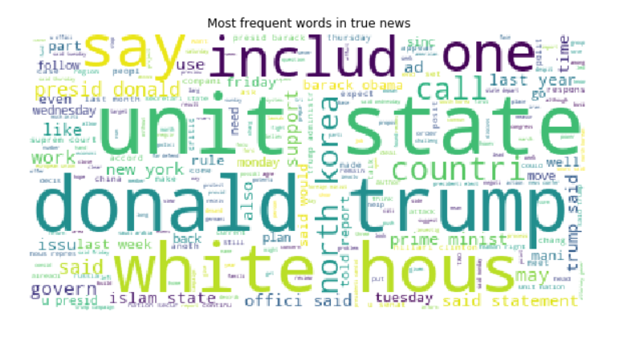
Findings
Most common words in real news articles:
Notes:
As you can see the most frequent words in both types of news articles are almost the same. This makes it harder for the model to correctly classify.
Also Hillary Clinton is nowhere to be seen in the real news dataset even though these were articles from 2016, the election year. It’s either the Democratic Party was so sure they will win the elections that they didn’t need a strong PR campaign, or they didn’t really believe in her or the internet was invaded by fake articles about Hillary Clinton. Maybe all three.
Donald Trump is in both of the datasets almost as frequent.

Slide 15
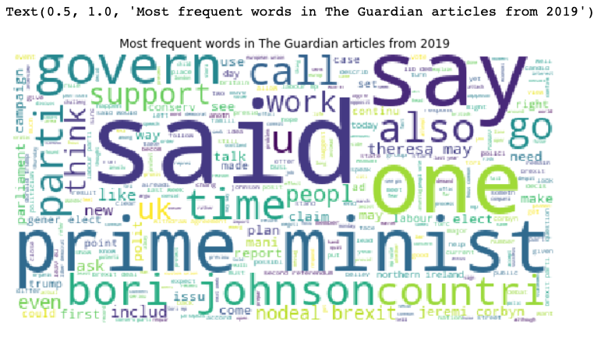
Findings
Most common words in The Guardian articles:
Notes:
You could see how we ended up with a very low recall score when testing on the scrapped data. The most frequent words in these articles have nothing in common with the real news articles.

Slide 16
Recommendations
A good fake news predicting model can:
1. help social media platforms quickly identify fake news articles,
2. help a political commentator identify a false claim and comment on it immediately.

Slide 17
Future work
Improve the models:
Tune KNNeighbours model to see if it performs better on the scrapped data.
Tune the other classifiers to avoid overfitting.
Improve the scrapped data by adding fake news articles.
Use Glove and word2vec and GausianNB since Glove doesn't work with MultinomialNB. MultinomialNB works with integer values (counts), although fractional counts are also possible to use. GaussianNB can take negative values.
Find a way to get different metrics like Recall in the Keras model.
Precision offers a good window into understanding false positives. In our case false positives are real negative tweets that are predicted to be positive by our model.
Notes:
These models cound be used by Facebook, Twitter or political commentators to rapidly identify fake news and inform the consumers about it. We care the most about having a high true positive rate and a low false negative rate, therefore we will be optimizing our models for recall. The reason behind my decision is that it is more damaging for your credibility if you report many false fake news ( Fake news that are in fact truthfull.) than letting go a few fake news. A false fake news article could be considered a deliberate political action and used against you. Lawsuits could follow.
Gaussian Naive Bayes is a variant of Naive Bayes that follows Gaussian normal distribution and supports continuous data.

Slide 18
Thank you

